Slide 1
IBM University Engagement Project Submission
“Exploring the Power of Agentic AI with IBM Granite and LangFlow”
Problem Statement No.22: Smart IoT Device Troubleshooting Chatbot

Slide 2
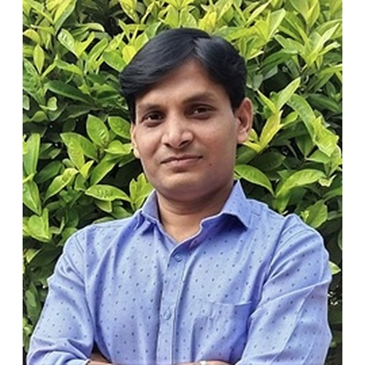
Project Tile – Smart IoT Device Troubleshooting Chatbot using Agentic AI
Domain of Project – IoT, Electronics,
Student Name | Recent Passport Photo | Email ID | Mobile number [WhatsApp]
Nitin Patel |  | nrpatel@mbit.edu.in | 9601196919

Slide 3
Problem Statement -
Problem Statement :
Modern IoT environments consist of numerous interconnected devices such as sensors, smart appliances, industrial equipment, and embedded systems. When these devices experience issues such as connectivity failures, sensor malfunctions, firmware errors, battery problems, or configuration errors, troubleshooting often requires technical expertise and significant manual effort. Traditional support systems rely on static FAQs, documentation, or human technicians, which can result in delayed issue resolution, increased operational costs, and prolonged device downtime. There is a need for an intelligent, autonomous, and context-aware troubleshooting assistant capable of diagnosing IoT device issues, suggesting corrective actions, and guiding users through the resolution process in real time.
The Challenge :
Diverse IoT Devices like Different manufacturers Different communication protocols, Different error formats
Real-Time Diagnostics Needed like for immediate analysis, Handling streaming device data
Knowledge Retrieval- Accessing large troubleshooting knowledge bases, Retrieving relevant solutions accurately
Multi-Step Reasoning- Diagnosing complex failures often requires multiple steps, Agent coordination is required
Data Integration- Integrating logs, sensors, and device status information
Context Management- Maintaining conversation history, Understanding previous troubleshooting attempts
Scalability- Supporting thousands of IoT devices simultaneously
Explainability- Providing understandable reasoning behind recommendations
Security and Privacy- Protecting device information, Secure communication between chatbot and IoT systems
Handling Uncertainty- Incomplete logs, Missing sensor data, Ambiguous user descriptions

Slide 4
The Objectives:
Develop an intelligent Agentic AI chatbot that can automatically diagnose and troubleshoot IoT device issues through natural language interaction.
Automate IoT device troubleshooting.
Provide real-time troubleshooting guidance.
Reduce device downtime.
Improve user experience.
Enable multi-step reasoning using AI agents.
Integrate IBM Granite Models for intelligent diagnosis.
Use LangFlow to orchestrate agent workflows.
Generate detailed troubleshooting reports.
Support multiple IoT device categories.
Reduce dependency on human support teams.

Slide 5
Technology Used
Tech Stack
For this project I used
LangFlow + IBM watsonx.ai + Granite Models

Slide 6
Proposed Solution -
Proposed Solution: Smart IoT Device Troubleshooting Chatbot using Agentic AI
The proposed system introduces an Agentic AI-powered chatbot capable of:
Understanding natural language complaints
Analysing device symptoms
Accessing IoT device information
Performing step-by-step diagnosis
Recommending corrective actions
Escalating unresolved issues
Learning from previous troubleshooting cases
Using LangFlow, multiple AI agents can collaborate to diagnose and resolve IoT-related problems.

Slide 7
Langflow component Used -
1) Chat Input – Interface where users enter their queries (text).
2) IBM watsonx AI Agent - Processes user input using Granite models to generate personalized Suggestions and recommendations on IoT related problems.
3) Name of IBM Granite model – ibm/granite-8b-code-instruct→ Fast, efficient for real-time IoT/hardware related queries
4) Device Identification Agent - It is responsible for identifying device, its type, its identification Number etc….
5) Knowledge Retrieval Agent - It is used to search Device manuals, Troubleshooting guides, FAQs, Firmware documentation etc…
6) Troubleshooting Agent – Its task is to Generate solution steps according to the query of user and retrieval knowledge from the sources..
4) Chat output -Displays AI-generated responses for IoT related issues like device\wi-fi\any network related issues and suggestions.

Slide 8
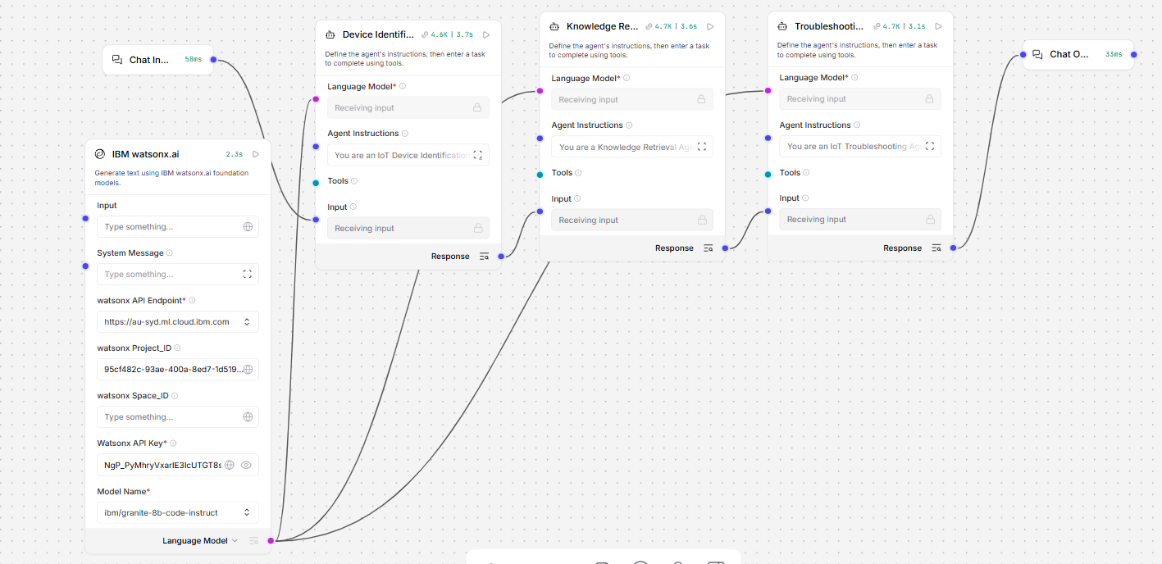
Langflow workflow -

Slide 9
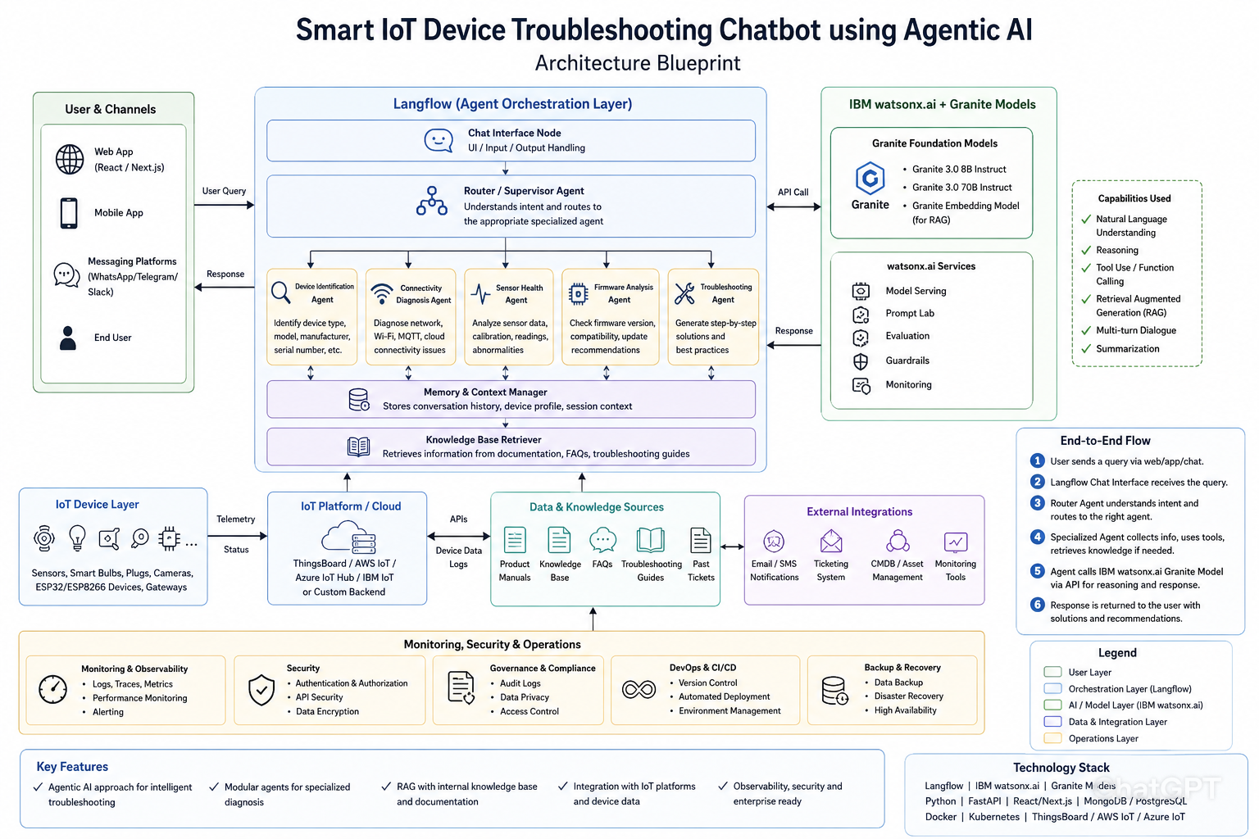
Architecture blueprint

Slide 10

Role of Agentic AI in the solution
Agentic AI is the core intelligence layer of this project. Unlike a traditional chatbot that simply answers questions, Agentic AI can analyze problems, make decisions, coordinate multiple tasks, retrieve information, and generate solutions autonomously.
In the proposed Smart IoT Device Troubleshooting Chatbot, Agentic AI acts as a virtual IoT support engineer that helps users diagnose and resolve device issues efficiently.
Key Roles of Agentic AI in this project is Autonomous Problem Understanding, Multi-Agent Coordination, Decision-Making and Planning and Personalized User Assistance.
Agentic AI transforms the chatbot from a simple question-answering system into an intelligent IoT troubleshooting assistant. It autonomously understands device issues, retrieves relevant knowledge, performs root-cause analysis, plans troubleshooting actions, coordinates multiple agents, and provides real-time conversational support, significantly reducing troubleshooting time and improving the overall user experience.
Agentic AI serves as the decision-making and orchestration engine of the Smart IoT Device Troubleshooting Chatbot, enabling autonomous diagnosis, knowledge retrieval, root-cause analysis, and intelligent troubleshooting of IoT device issues.
The multi-agent approach ensures efficient task execution and accurate results.

Slide 11
Technology Used
Langflow platform -For designing and orchestrating multi-agent workflows visually
IBM Grainte model - for eg – ibm/granite-8b-code-instruct – For natural language understanding, reasoning, and personalization
IBM Cloud – It provides the infrastructure to build, deploy, and scale the Agent efficiently. IBM Cloud enables a reliable, secure, and scalable environment for deploying the IoT Agent.
RAG– RAG to fetch real data first, then generate intelligent answers, making the IoT Agent more trustworthy and effective.
IBM Watsonx.ai - For model deployment, embeddings, and AI governance

Slide 12
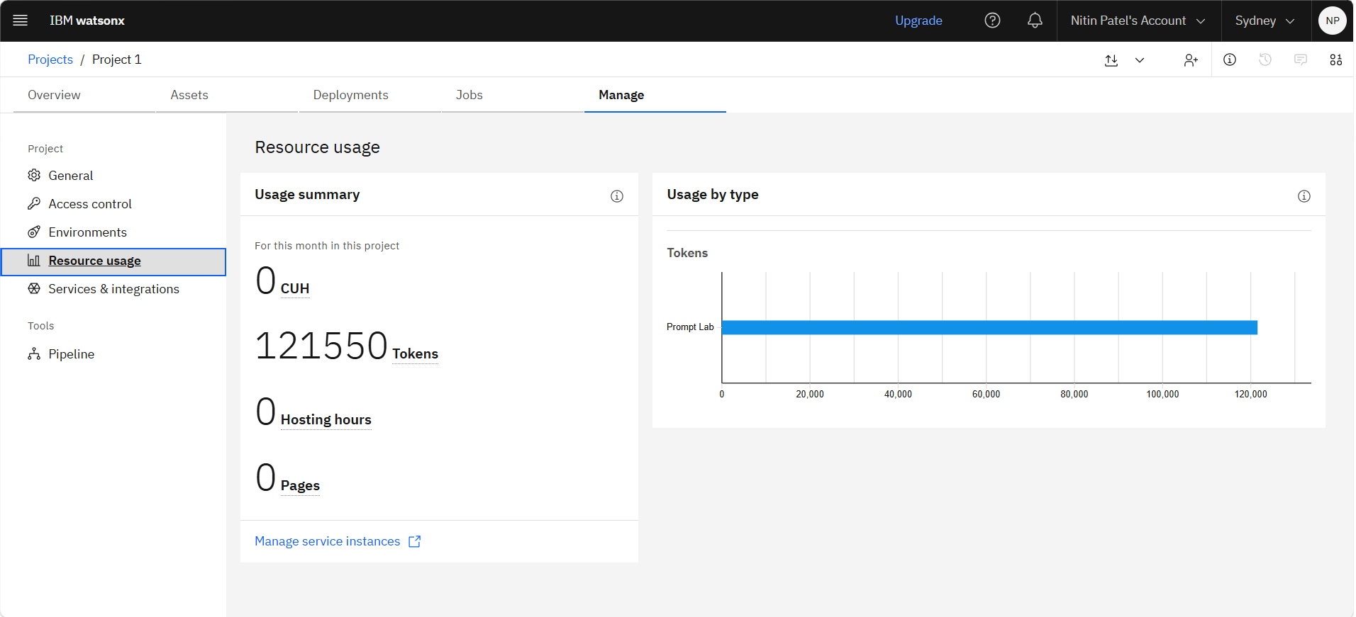
Token Usage
11,761 token are used
·
·
·

Slide 13
Novelty and Uniqueness
The proposed system introduces an Agentic AI-based multi-agent troubleshooting framework that autonomously diagnoses IoT device issues, retrieves knowledge from technical documentation, performs root-cause analysis, and provides explainable, personalized solutions through natural language interaction.
The novelty of your project lies in the fact that it is not just a chatbot—it is an Agentic AI-powered autonomous troubleshooting assistant for IoT devices.
Agentic AI-Based Troubleshooting Instead of Traditional Chatbot Responses : The chatbot behaves like a virtual IoT support engineer rather than a simple question-answering system.
Multi-Agent Architecture : Each agent has a dedicated role, making the system more intelligent, modular, and scalable.
Intelligent Root Cause Analysis : The system performs AI-driven reasoning similar to a human technician.
Dynamic and Personalized Troubleshooting : The troubleshooting process becomes adaptive and interactive.
Integration of LangFlow + IBM watsonx.ai + Granite Models : Demonstrates a modern enterprise-grade Agentic AI workflow.
Potential for Predictive Maintenance (Future) : Moves beyond troubleshooting into proactive device maintenance.

Slide 14
Git Hub Link
·
https://github.com/nitin242280-prog/NRP-IBM-Project
·
·
·

Slide 15
Future Scope
Future Scope is to Transform the chatbot into an autonomous Agentic AI-powered IoT support platform capable of monitoring, diagnosing, predicting, and resolving IoT device issues with minimal human intervention.
Self-Healing IoT Systems: Future Agentic AI systems can automatically Restart services, Reconnect devices, Reset network settings, Apply configuration fixes without user intervention.
Security and Vulnerability Detection: Future agents can identify Weak passwords, Open ports, Firmware vulnerabilities and also Unauthorized access attempts.
Multi-Language Support: Current system may support only English. Future enhancement in Hindi, Gujarati and other regional languages.
Image-Based Device Diagnosis: Users can upload images of Sensors, Smart devices, Error displays, Circuit boards. The AI can analyze Physical damage, Error indicators and Wiring issues
Automatic Firmware Management : Future versions can Detect outdated firmware. Check manufacturer updates. Recommend firmware upgrades. Assist users through update procedures.
·
·
·

Slide 16
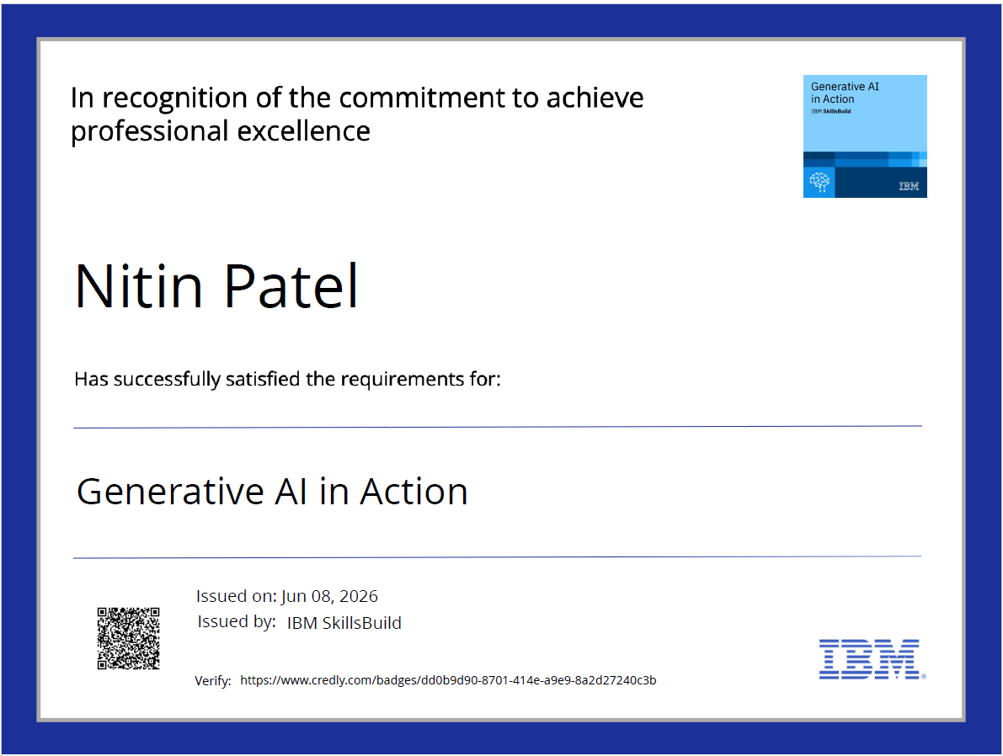
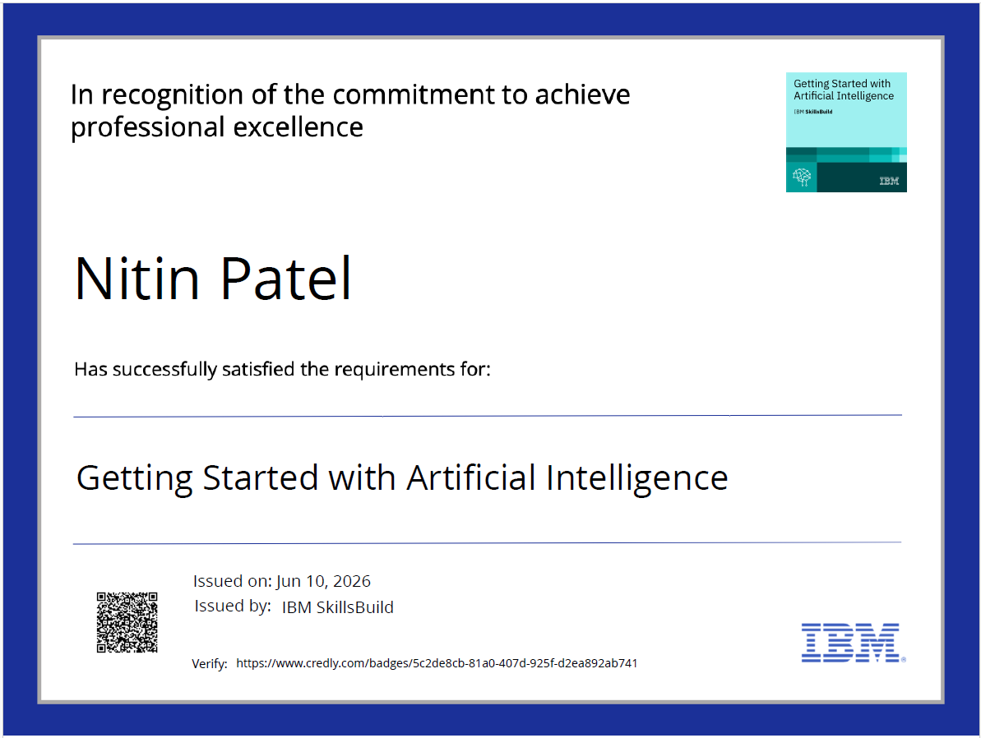
Certificates Earned:

Slide 17
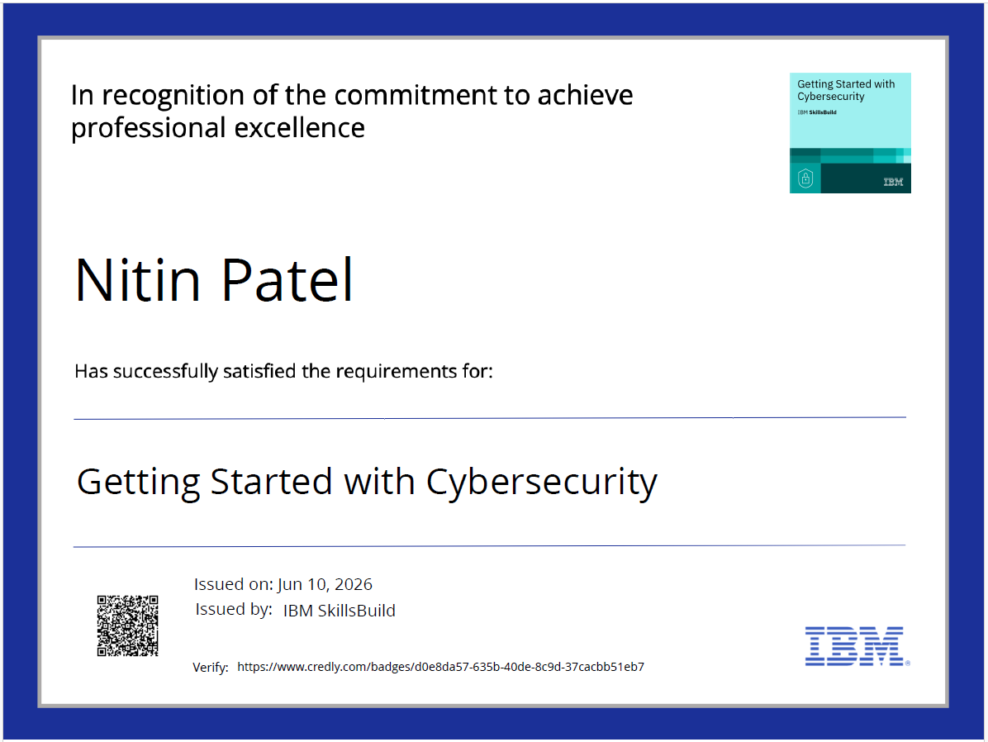
Certificates Earned:

Slide 18
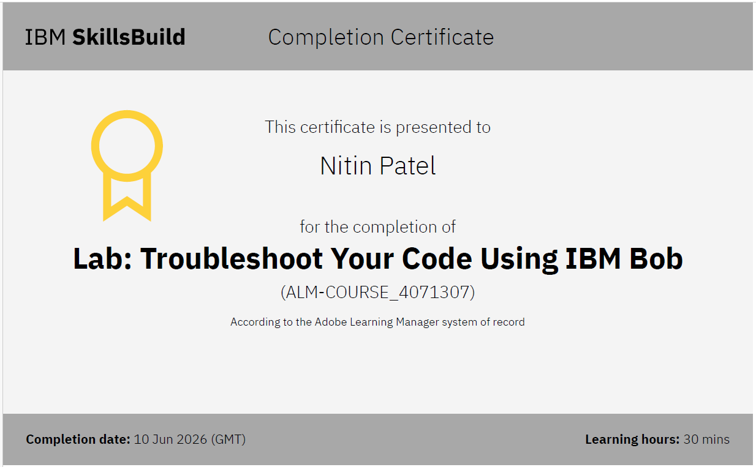
Certificates Earned:​

Slide 19


